Slide 1
Introduction to Data Science
Unit 1

Slide 2
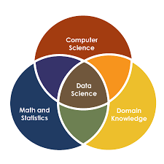
What is Data Science?
Data Science is an interdisciplinary field that involves extracting insights and knowledge from various forms of data using scientific methods, processes, algorithms, and systems.
It encompasses the entire data lifecycle, from defining research goals to presenting results to stakeholders.

Slide 3
Data analytics
Data analytics converts raw data into actionable insights.
It includes a range of tools, technologies, and processes used to find trends and solve problems using data.
Data analytics can shape business processes, improve decision-making, and foster business growth.
Link: https://aws.amazon.com/what-is/data-analytics/

Slide 4
Business intelligence
Business intelligence (BI) is a set of technological processes for collecting, managing and analyzing organizational data to yield insights that inform business strategies and operations.
Business intelligence analysts transform raw data into meaningful insights that drive strategic decision-making within an organization.
Link: https://www.ibm.com/think/topics/business-intelligence

Slide 5
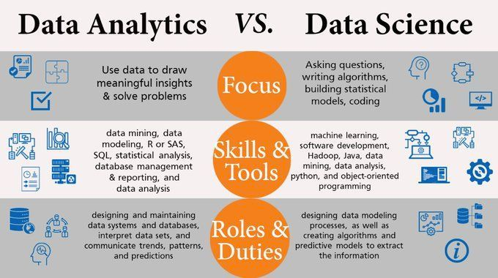

Slide 6
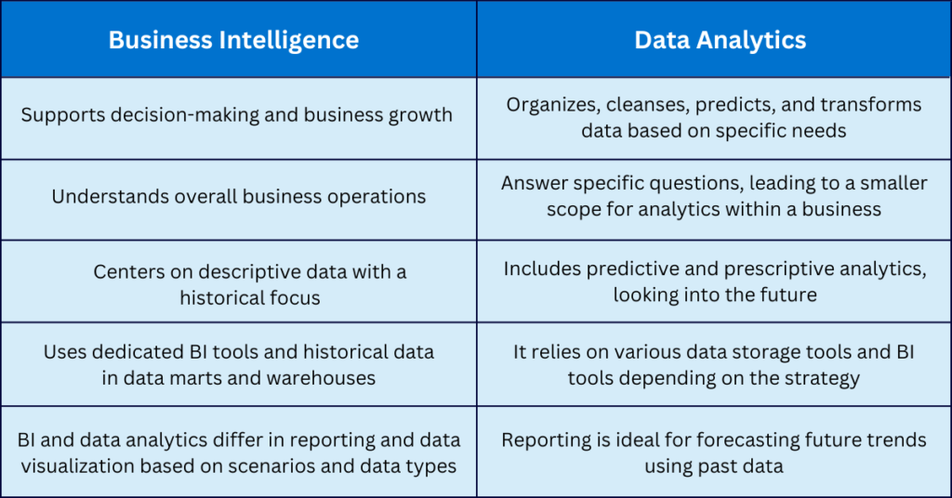

Slide 7
Real-World Example: Netflix
To understand how these three fields work together, let's look at how Netflix uses each one.
1. Business Intelligence (BI): "What happened?"
BI looks at historical data to track performance. It helps executives see the "health" of the business.
The Question: "How many new subscribers did we gain last quarter in India compared to Germany?"
The Output: A dashboard showing a bar chart of subscriber growth by region for Q4 2025.
The Goal: To monitor business metrics (KPIs) and report on revenue and growth.

Slide 8
2. Data Analytics: "Why did it happen?"
Analytics digs deeper into specific data to find patterns or answer specific questions.
It usually involves a human analyst processing data to solve a problem.
The Question: "Why did subscriber churn increase by 5% last month?"
The Output: An analyst discovers that users who watched a specific show were 3x more likely to unsubscribe.
The Goal: To find the root cause of trends and actionable insights to improve immediate performance.

Slide 9
3. Data Science: "What will happen next?"
Data Science builds systems that automatically process data to predict the future or create new features. It uses algorithms rather than just human analysis.
The Question: "Which movies should we recommend to User X to ensure they don't cancel their subscription?"
The Output: The Recommendation Engine. A machine learning model processes your viewing history and predicts that you are 85% likely to enjoy Stranger Things, placing it at the top of your feed.
The Goal: To build predictive models and automated products (like AI) that continuously learn and improve.

Slide 10
Data Science in the Big Data World
In data science and big data you’ll come across many different types of data, and each of them tends to require different tools and techniques. The main categories of data are these:
■ Structured
■ Unstructured
■ Natural language
■ Machine-generated
■ Graph-based
■ Audio, video, and images
■ Streaming

Slide 11
Structured Data
Structured data is data that depends on a data model and resides in a fixed field within a record.
Ex: data in tables within databases or Excel files.
SQL, or Structured Query Language, is the preferred way to manage and query data that resides in databases.
The world isn’t made up of structured data, though; it’s imposed upon it by humans and machines. More often, data comes unstructured.

Slide 12
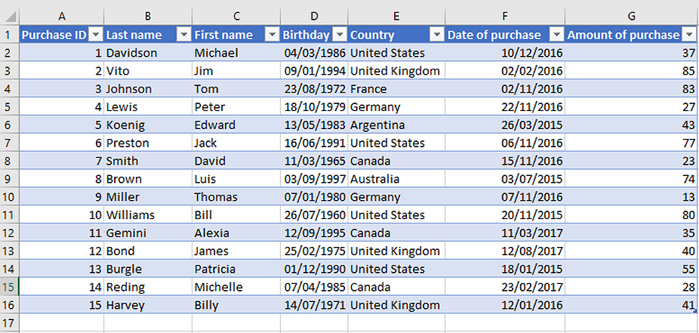

Slide 13
Unstructured Data
Unstructured data is data that isn’t easy to fit into a data model because the content is context-specific or varying.
Ex: email.
Although email contains structured elements such as the sender, title, and body text, it’s a challenge to find the number of people who have written an email complaint about a specific employee because so many ways exist to refer to a person.
The thousands of different languages and dialects out there further complicate this.

Slide 14
Unstructured Data
Unstructured data is data that isn’t easy to fit into a data model because the content is context-specific or varying.
Ex: email.
The thousands of different languages and dialects out there further complicate this.

Slide 15


Slide 16
Natural Language
Natural language is a special type of unstructured data; it’s challenging to process because it requires knowledge of specific data science techniques and linguistics.
The natural language processing community has had success in entity recognition, topic recognition, summarization, text completion, and sentiment analysis, but models trained in one domain don’t generalize well to other domains.

Slide 17
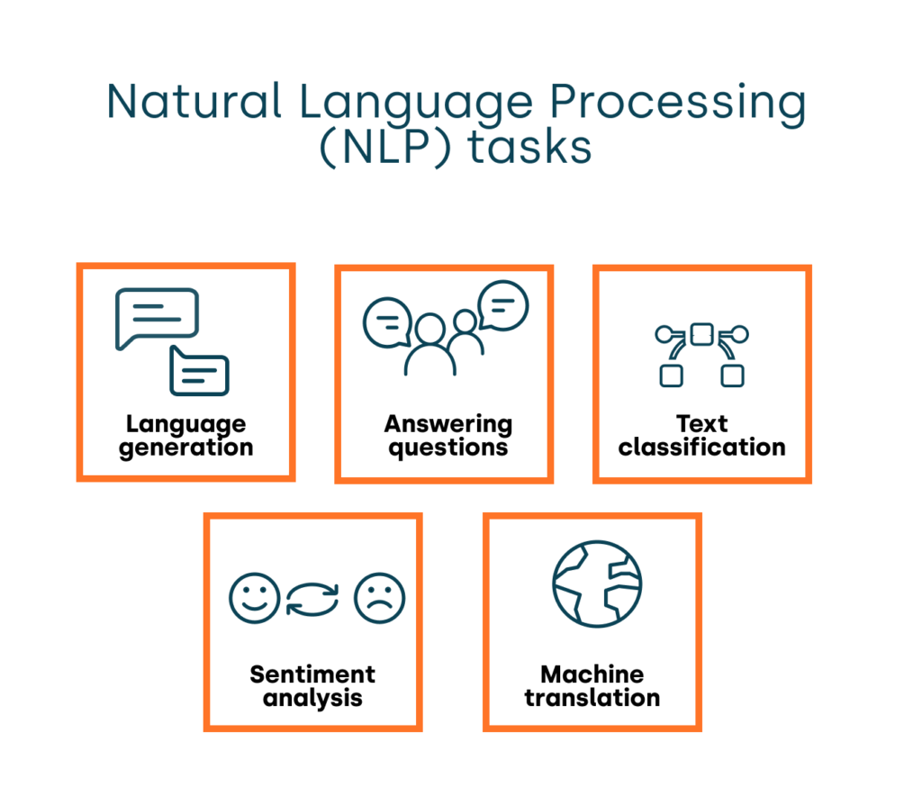

Slide 18
Machine Generated
Machine-generated data is information that’s automatically created by a computer, process, application, or other machine without human intervention.
The analysis of machine data relies on highly scalable tools, due to its high volume and speed.
Examples of machine data are web server logs, call detail records, network event logs, and telemetry.

Slide 19
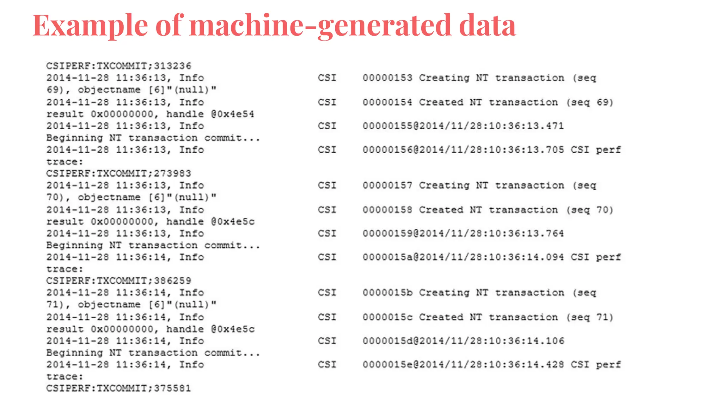

Slide 20
Graph Based, Audio, Videos,
Graph or network data is, in short, data that focuses on the relationship or adjacency of objects.
The graph structures use nodes, edges, and properties to represent and store graphical data.
Graph-based data is a natural way to represent social networks, and its structure allows you to calculate specific metrics such as the influence of a person and the shortest path between two people.
Examples of graph-based data can be found on many social media websites.
Graph databases are used to store graph-based data and are queried with specialized query languages such as SPARQL.

Slide 21
Examples
For instance, on LinkedIn you can see who you know is at which company.
Your follower list on Twitter is another example of graph-based data.
For example, imagine the connecting edges to show “friends” on Facebook.
Imagine another graph with the same people which connects business colleagues via LinkedIn.
Imagine a third graph based on movie interests on Netflix.

Slide 22
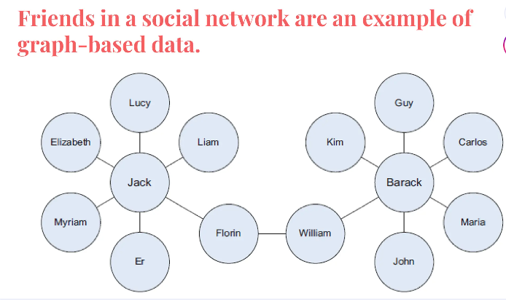

Slide 23
Audio,Image & Video Data
Audio, image, and video are data types that pose specific challenges to a data scientist.
Tasks that are trivial for humans, such as recognizing objects in pictures, turn out to be challenging for computers.
MLBAM (Major League Baseball Advanced Media) announced in 2014 that they’ll increase video capture to approximately 7 TB per game for the purpose of live, in-game analytics.
High-speed cameras at stadiums will capture ball and athlete movements to calculate in real time, for example, the path taken by a defender relative to two baselines.
Recently a company called DeepMind succeeded at creating an algorithm that’s capable of learning how to play video games. This algorithm takes the video screen as input and learns to interpret everything via a complex process of deep learning.

Slide 24
Streaming Data
The data flows into the system when an event happens instead of being loaded into a data store in a batch.
Examples are the “What’s trending” on Twitter, live sporting or music events, and the stock market.

Slide 25
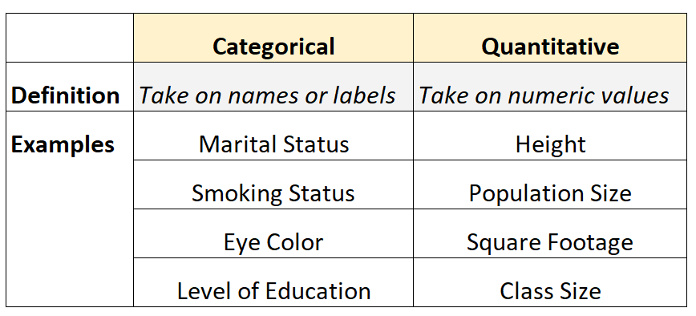
Quantitative Vs Categorical Data

Slide 26
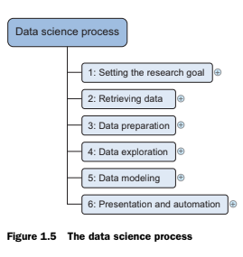
The Data Science Process- Defining Research Goals
The data science process typically consists of six steps.

Slide 27
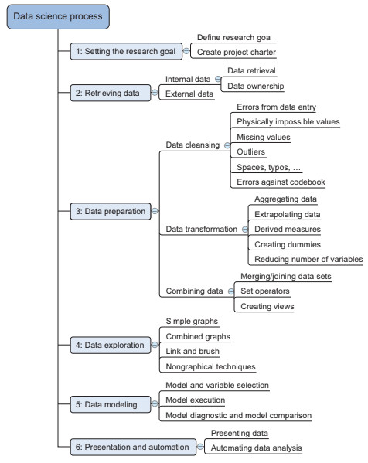

Slide 28
The following is a short introduction of each step:
Setting the research goal
The first step of this process is to set the research goal. The main purpose here is making sure all the stakeholders understand the what, how and why of the project. In every project this will result in a project charter.
Retrieving data
The second step is to collect data. You want to have data available for analysis, so this step includes finding suitable data and getting access to data from the data owner. The result is data in its raw form, which probably needs polishing and transformation before it becomes usable.

Slide 29
3. Data preparation
Data collection is an error-prone process; in this phase you enhance the quality of the data and prepare it for use in subsequent steps. This phase consists of three sub- phases: data cleansing removes false values from a data source and inconsistencies across data sources, data integration enriches data sources by combining information from multiple data sources, and data transformation ensures that the data is in a suitable format for use in your models.
4. Data exploration
Data exploration is concerned with building a deeper understanding of your data. You try to understand how variables interact with each other, the distribution of the data, and whether there are outliers. To achieve this you mainly use descriptive statistics, visual techniques, and simple modeling. This step often goes by the abbreviation EDA, for Exploratory Data Analysis.

Slide 30
5. Data modeling or model building
In this phase you use models, domain knowledge, and insights about the data you found in the previous steps to answer the research question. You select a technique from the fields of statistics, machine learning, operations research, and so on. Building a model is an iterative process that involves selecting the variables for the model, executing the model, and model diagnostics.
6. Presentation and automation
Finally, you present the results to your business. These results can take many forms, ranging from presentations to research reports. Sometimes you’ll need to automate the execution of the process because the business will want to use the insights you gained in another project or enable an operational process to use the outcome from your model.

Slide 31
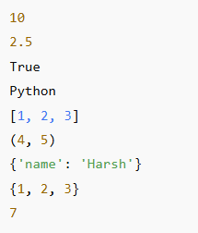
Python for Data Science
Data Types-int, float, bool, str, list, tuple, dictionary, set, Functions.
Ex:
a = 10 # int
b = 2.5 # float
c = True # bool
d = "Python" # str
e = [1, 2, 3] # list
f = (4, 5) # tuple
g = {"name": "Harsh"} # dictionary
h = {1, 2, 3} # set
def add(x, y): # function
return x + y
print(a, b, c, d, e, f, g, h)
print(add(3, 4))

Slide 32

NumPy stands for Numerical Python.
It is a Python library used for numerical and scientific computing.
NumPy is used because it is:
Faster than Python lists
Memory efficient
Easy to perform mathematical operations
Widely used in data science, AI, ML, and scientific computing

Slide 33
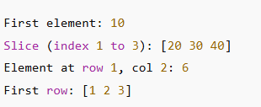
Exploring NumPy Library- Indexing, Slicing
import numpy as np
# Create a NumPy array
arr = np.array([10, 20, 30, 40, 50])
# Indexing
print("First element:", arr[0])
# Slicing
print("Slice (index 1 to 3):", arr[1:4])
# 2D Array example
mat = np.array([[1, 2, 3], [4, 5, 6]])
print("Element at row 1, col 2:", mat[1, 2])
print("First row:", mat[0, :])

Slide 34
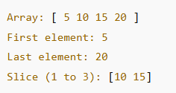
One dimensional Array
import numpy as np
# One-dimensional array
arr = np.array([5, 10, 15, 20])
# Access elements
print("Array:", arr)
print("First element:", arr[0])
print("Last element:", arr[-1])
# Slicing
print("Slice (1 to 3):", arr[1:3])

Slide 35
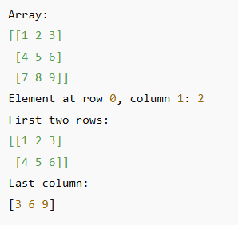
Multi-Dimensional Array
import numpy as np
# Create a 2D array
arr = np.array([[1, 2, 3],
[4, 5, 6],
[7, 8, 9]])
# Access elements (indexing)
print("Array:")
print(arr)
print("Element at row 0, column 1:", arr[0, 1])
# Slicing
print("First two rows:")
print(arr[0:2, :])
print("Last column:")
print(arr[:, -1])

Slide 36

Concatenation and Splitting Arrays
import numpy as np
# Create arrays
a = np.array([1, 2, 3])
b = np.array([4, 5, 6])
# Concatenation
concat_arr = np.concatenate((a, b))
print("Concatenated array:", concat_arr)
# Splitting
split_arr = np.split(concat_arr, 2)
print("Split arrays:", split_arr)

Slide 37
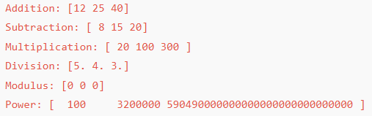
Arithmetic operations
import numpy as np
# Create arrays
a = np.array([10, 20, 30])
b = np.array([2, 5, 10])
# Arithmetic operations
print("Addition:", a + b)
print("Subtraction:", a - b)
print("Multiplication:", a * b)
print("Division:", a / b)
print("Modulus:", a % b)
print("Power:", a ** b)

Slide 38
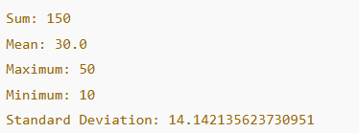
Aggregation
import numpy as np
# Create an array
arr = np.array([10, 20, 30, 40, 50])
# Aggregation operations
print("Sum:", np.sum(arr))
print("Mean:", np.mean(arr))
print("Maximum:", np.max(arr))
print("Minimum:", np.min(arr))
print("Standard Deviation:", np.std(arr))

Slide 39

Sorting - Numbers
import numpy as np
# Create an array
arr = np.array([40, 10, 30, 20])
# Sorting
sorted_arr = np.sort(arr)
print("Original array:", arr)
print("Sorted array:", sorted_arr)

Slide 40

Sorting - Text
# List of text values
words = ["banana", "apple", "cherry", "date"]
# Sorting text
sorted_words = sorted(words)
print("Original list:", words)
print("Sorted list:", sorted_words)
🔹 Text is sorted alphabetically (lexicographical order).
🔹 Uppercase letters are sorted before lowercase by default.

Slide 41
Sorting using Numpy
import numpy as np
words = np.array(["banana", "apple", "cherry", "date"])
sorted_words = np.sort(words)
print("Sorted words:", sorted_words)
Sorted words: ['apple' 'banana' 'cherry' 'date']

Slide 42
Partitioning
import numpy as np
# Create an array
arr = np.array([40, 10, 30, 20, 50])
# Partition the array (element at index 2 will be in correct position)
part_arr = np.partition(arr, 2)
print("Original array:", arr)
print("Partitioned array:", part_arr)
Original array: [40 10 30 20 50]
Partitioned array: [20 10 30 40 50]

Slide 43
Example on Strings
import numpy as np
# Array of text
words = np.array(["banana", "apple", "cherry", "date", "fig"])
# Partition based on index 2
part_words = np.partition(words, 2)
print("Original words:", words)
print("Partitioned words:", part_words)
Original words: ['banana' 'apple' 'cherry' 'date' 'fig']
Partitioned words: ['apple' 'banana' 'cherry' 'date' 'fig']

Slide 44
import numpy as np
words = np.array(["orange", "grape", "apple", "mango", "banana"])
part_words = np.partition(words, 1)
What np.partition() does:
np.partition(array, k) rearranges the array so that the element that would be at position k in a fully sorted array is placed at index k.
All elements before index k are alphabetically smaller than that element.
All elements after index k are alphabetically larger.
The elements on either side are not fully sorted.
partition() is faster than full sorting when you only need a specific position (like finding the smallest or second smallest element), not the entire sorted list.

